Slide 1
SECON Robot 2025 Detail Design Presentation
Presented by: Sean Borchers, Alexander Cruz, Samuel Hunter, Alejandro Moore, and Dakota Moye

Slide 2
Problem Formulation
SECON hosts an autonomous robot competition every year.
SECON 2025: Mining Mayhem
Navigate open field and dark enclosure
Collect materials placed randomly on the field and in the dark enclosure
Deposit materials into containers
Enter and exit the dark enclosure
Move containers to final location
Place beacon mast in mast hole

Slide 3
Specifications and Constraints
Specifications
The robot shall act autonomously. Rule G08.
The team shall design a robot to earn as many points as possible.
The robot may score 5 points by moving out of the landing pad.
The robot may score 5 points by moving out of the landing pad within 3 seconds of the Start LED.
The robot may score 15 points by moving into the cave.
The team may score 5 points by entering the Promotional Design Competition.
The robot may score 60 points for putting both containers in the correct zone.
The robot may score 34 points by completely supporting all Astral Material.
The robot may score 80 points by putting all Nebulite in its container.
The robot may score 108 points by putting all Geodinium in its container.
The robot may score 40 points for putting the Team Beacon in the Beacon Mast.
The robot shall fit within a cube with 12 inches per side at the start of the match. Rule G04.
The robot shall be able to detect the walls of the arena, walls of the cave, and cave entrance. Rule S03 states that if the robot causes field damage, the team will be penalized. Detecting walls stops the robot from causing damage by moving into it.
The robot shall stay on the game field. Rule S01.
The robot may have a single, simple electrical start button that shall be clearly labelled. The operation of this button shall prevent the robot from moving for five seconds. Rule R03.
The robot shall have a clearly labelled emergency stop button that immediately halts all functions safely and quickly. Rule R05.
The robot shall have a source of identification clearly associating it with Tennessee Technological University. Rule R10.
The robot may use light sources that shall not strobe, be excessively bright, or pose safety issues. Rule R17.
The robot shall cease operation of all its units after the allotted 3-minute timeframe of play is over, and no game element positions can be disturbed after time expires. Rule G07.
The robot shall account for background interference in the competition environment. Rule R13.
The robot shall sustain power of 30V maximum. Rule R16.
Constraints
The robot shall read April Tags to help with Specifications 1, 2e, 2g, 2h, and 2i.
The robot shall have a user manual that explains functionality and design intent for each subsystem.
The robot shall adhere to applicable requirements in standard IEC 60204-1 pertaining to electrical supply, electromagnetic compatibility, emergency stop, and control circuit protection. The power-based and electromagnetic interactions of components in the motor control subsystem will need to adhere to this standard.

Slide 4
Broader Impacts
Cultural/social factor for Tennessee Tech
Performing well in the competition would benefit the outreach capabilities of Tennessee Tech, increasing university prestige and encouraging students to participate in future events

Slide 5
Conceptual Solution
Camera
The camera (Intel D435) will be used for object detection, localization, and reading the April Tags on the board.
Sensors
Some sensors (including an Optical Tracking Odometry Sensor unit, multiple LiDAR units, a photoresistor, and an IMU) provide data for localization
Other sensors (including Hall Effect and line break sensors) will be used to track the astral material internally
Navigation and Master Control
A Jetson Nano will be used to interpret the data from the sensors and camera subsystems.
The Jetson Nano will send desired positions to the motor control subsystem
Motor Control
An Arduino will interpret the commands from the master control subsystem and send commands to the drive train, auger, roller, and beacon placement mechanism.

Slide 6
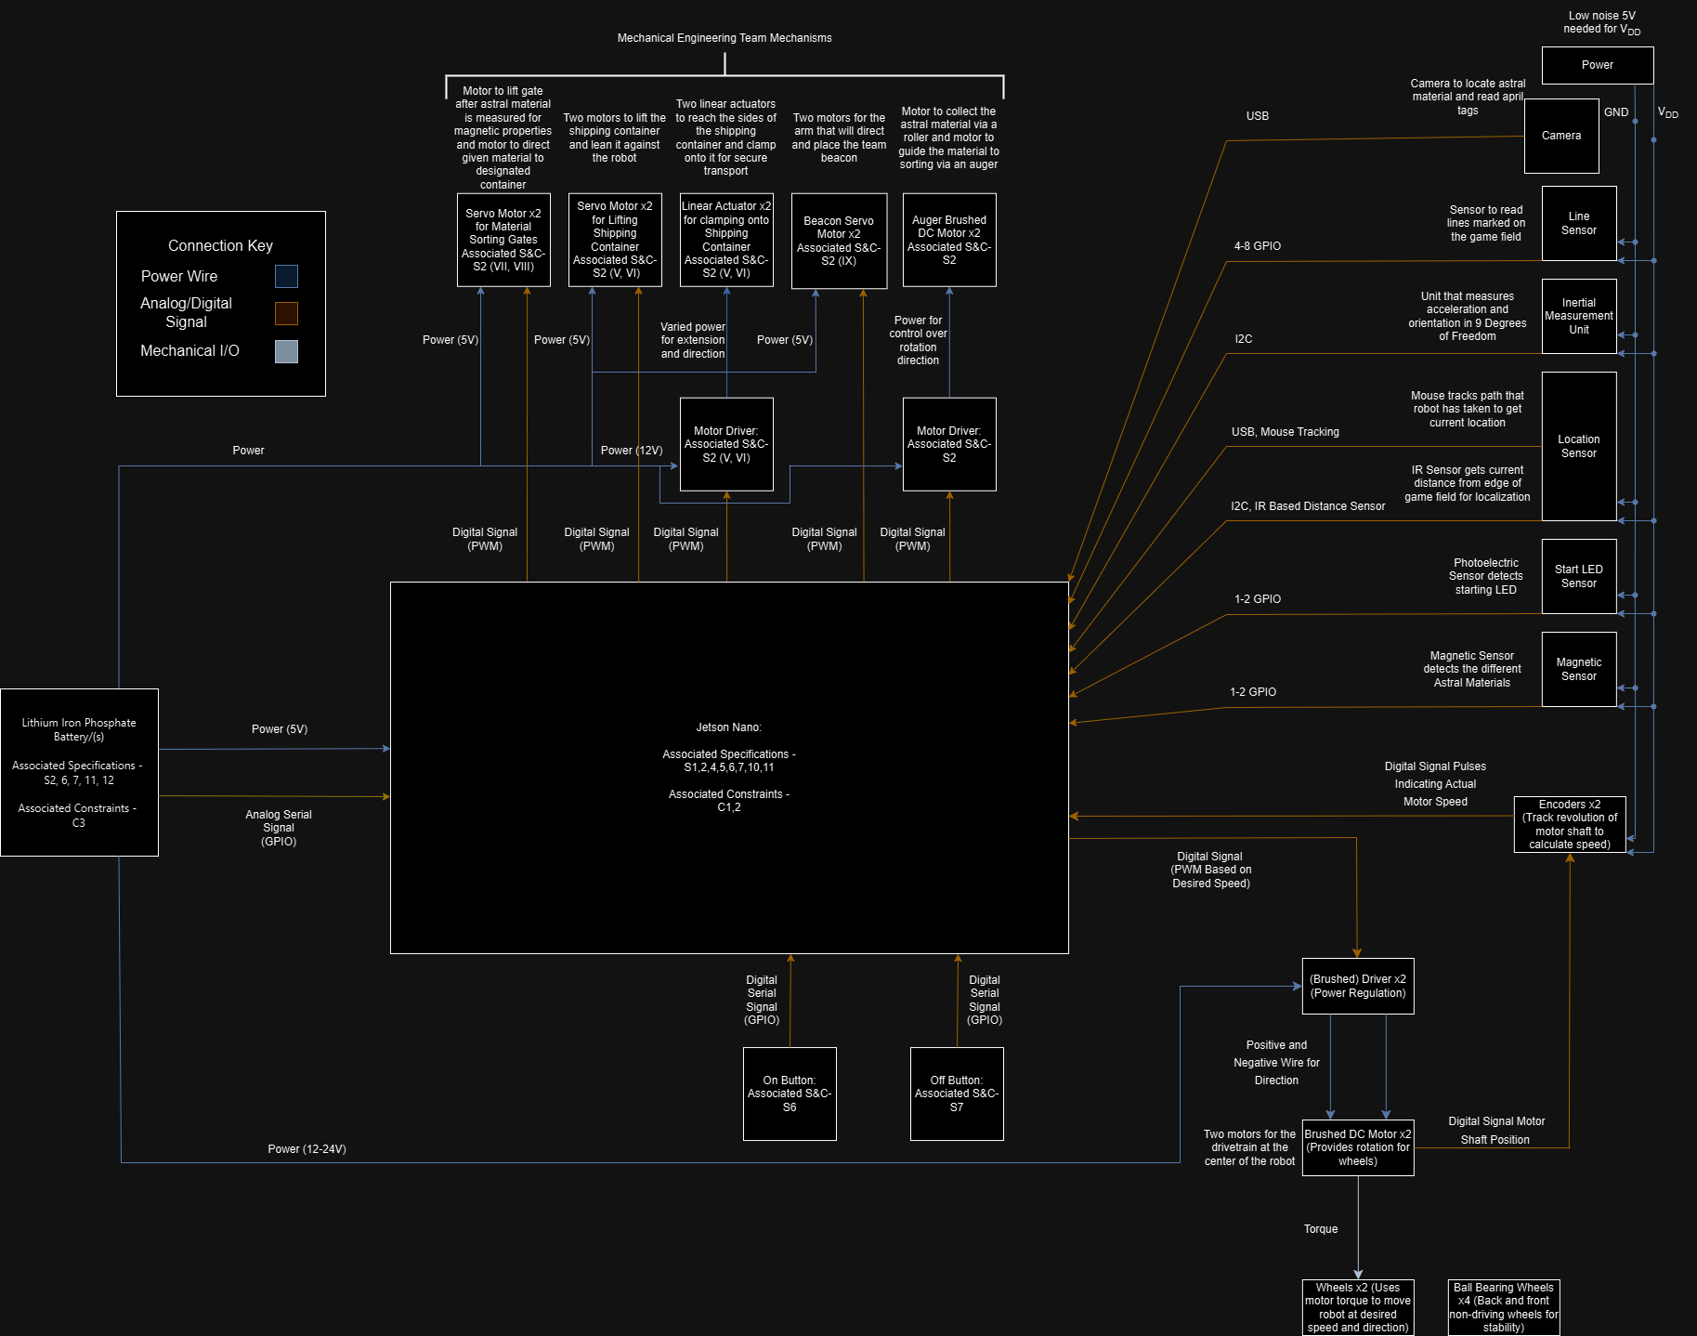

Slide 7
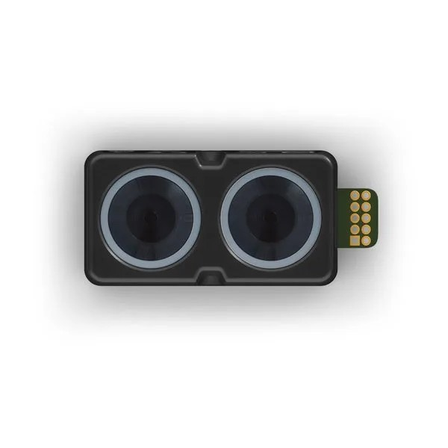
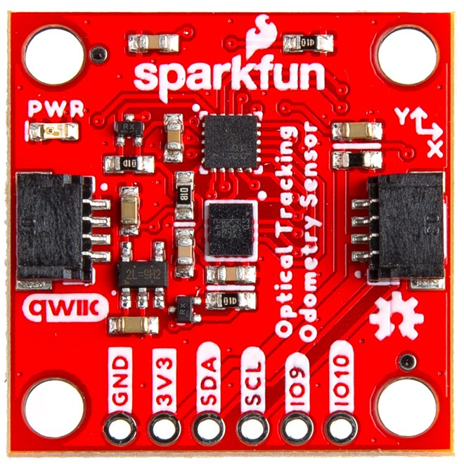
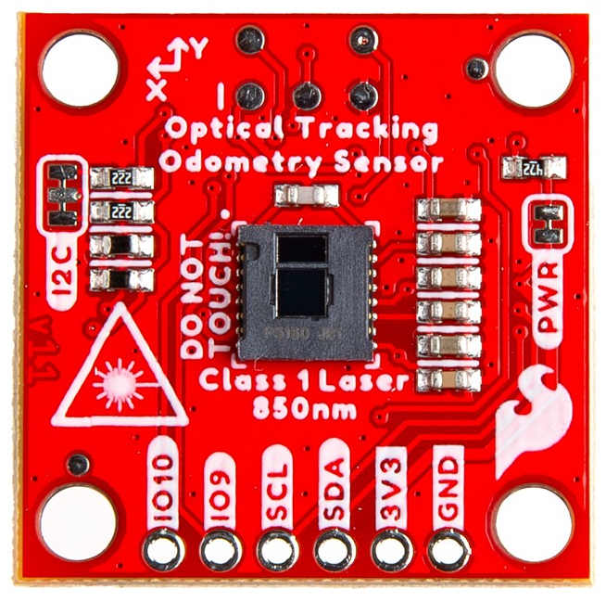
Sensors Subsystem
Goals
Detect the Start LED
Detect when a material has been collected
Identify the type of material collected
Identify the robot’s position
Constraints
The robot shall be able to count the number of materials collected and deposited.
The robot shall know its current position.
The distance sensor shall detect a maximum of 8 ft, or 2.4 m.
The magnetic sensor shall provide a signal that is larger than the resolution of the Arduino's Analog-to-Digital Converter.
The light detector shall provide a signal visible through the background noise.
The robot's general sensor subsystem shall have a user manual that explains functionality and design intent.
Solutions
Garmin LIDAR-Lite v4 LED
Provides positional feedback
Provides on board processing
SparkFun Optical Tracking Odometry Sensor (OTOS)
Provides velocity and acceleration feedback that is transformed to positional feedback
Provides on board processing
Photoresistors (GL125 Series)
Detects light
Will be filtered for background noise
Analog Hall Effect Sensors (AH49E)
Detects magnetic field in 1 dimension.
Garmin LIDAR-Lite v4 LED
SparkFun Optical Tracking Odometry Sensor (OTOS) Top Panel
SparkFun Optical Tracking Odometry Sensor (OTOS) Bottom Panel

Slide 8
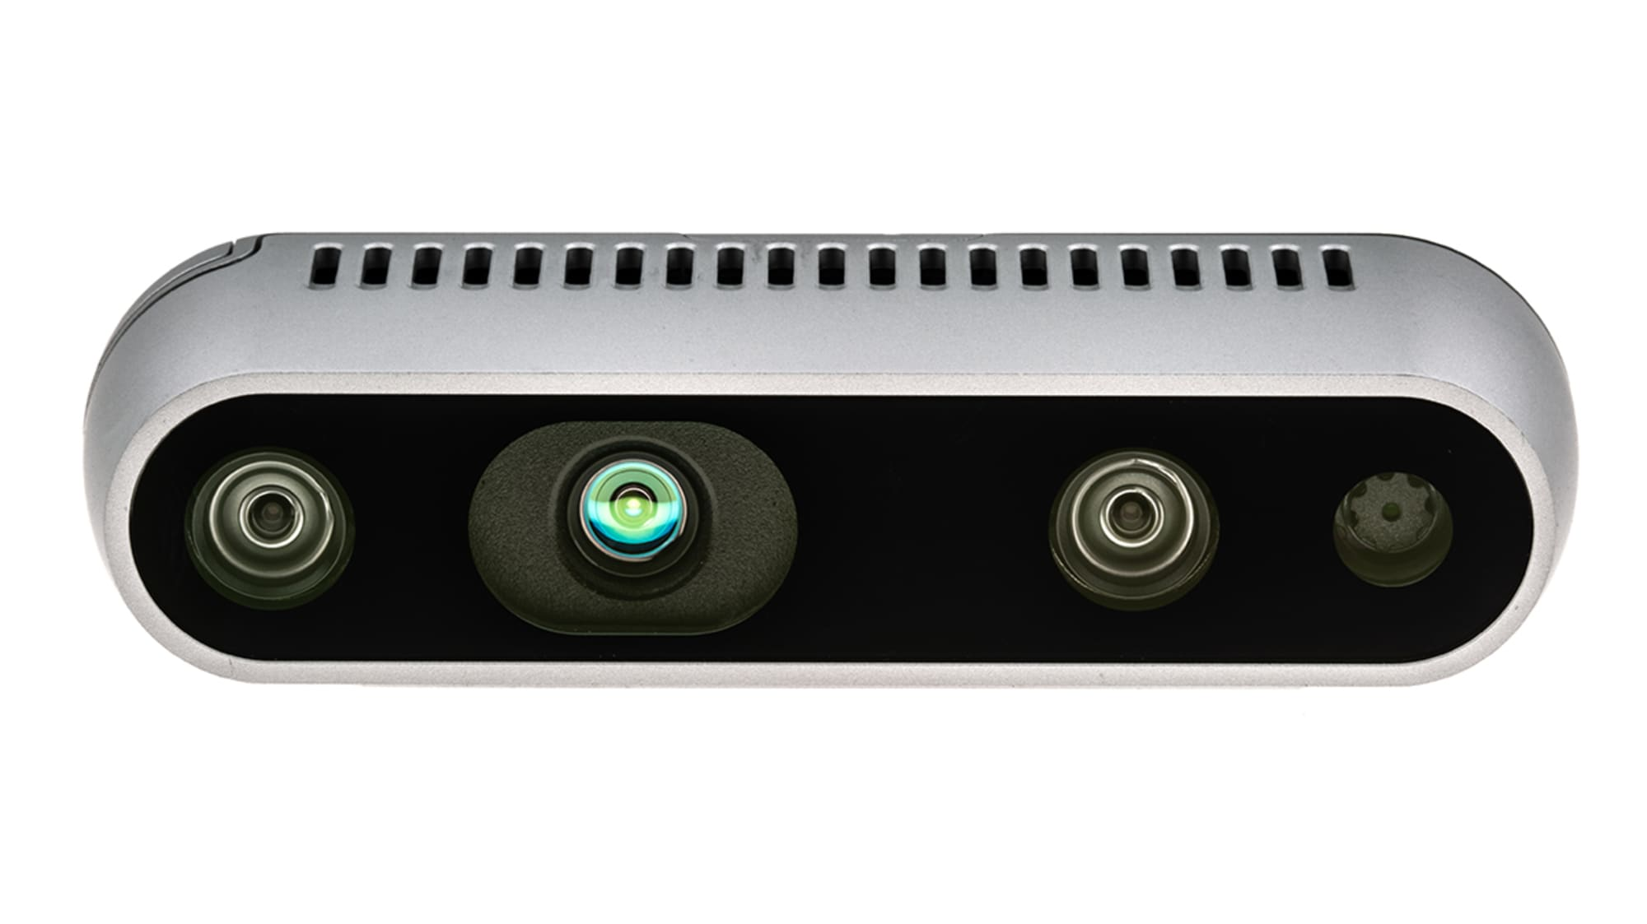
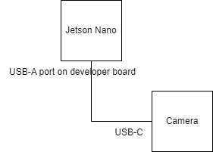
Object and Line Detection
Specifications
The robot shall act autonomously [S1].
The camera shall detect the Nebulite [S2-vii].
The camera shall detect the Geodinium [S2-viii].
The robot shall be able to detect the walls of the arena, walls of the cave, and cave entrance. Rule S03 states that if the robot causes field damage, the team will be penalized. Detecting walls stops the robot from causing damage by moving into it. The camera will be the only sensor on the front and will need to do the listed objectives [S4].
The camera shall read April Tags to help with Specifications 1, 2-v, 2-vii, 2-viii, and 2-ix [C1].
Constraints
The camera will be able to work in both light and dark conditions
In order to keep costs down the robot will only have 1 RGBD camera
The robot will be able detect the white lines on the game field
Solution
The robot shall have an Intel Realsense D435 stereoscopic depth camera
This camera will provide an image input for the robot, this input can the processed by various algorithms in order to give the robot useful information about elements of the game field such as
Objects, such as the astral material, shipping containers, and walls
Lines, including the lines to help navigate inside and outside the cave and the lines denoting the telemetry zones for the shipping containers
April tags, the robot will need to be able to read the apri tags in order to properly sort the shipping containers.
In order to make use of the information from the camera and give the information about the elements described above the robot will make use of several image processing algorithms , which include
Object Detection
Line Detection
Image processing for april tags
Image Processing for walls

Slide 9
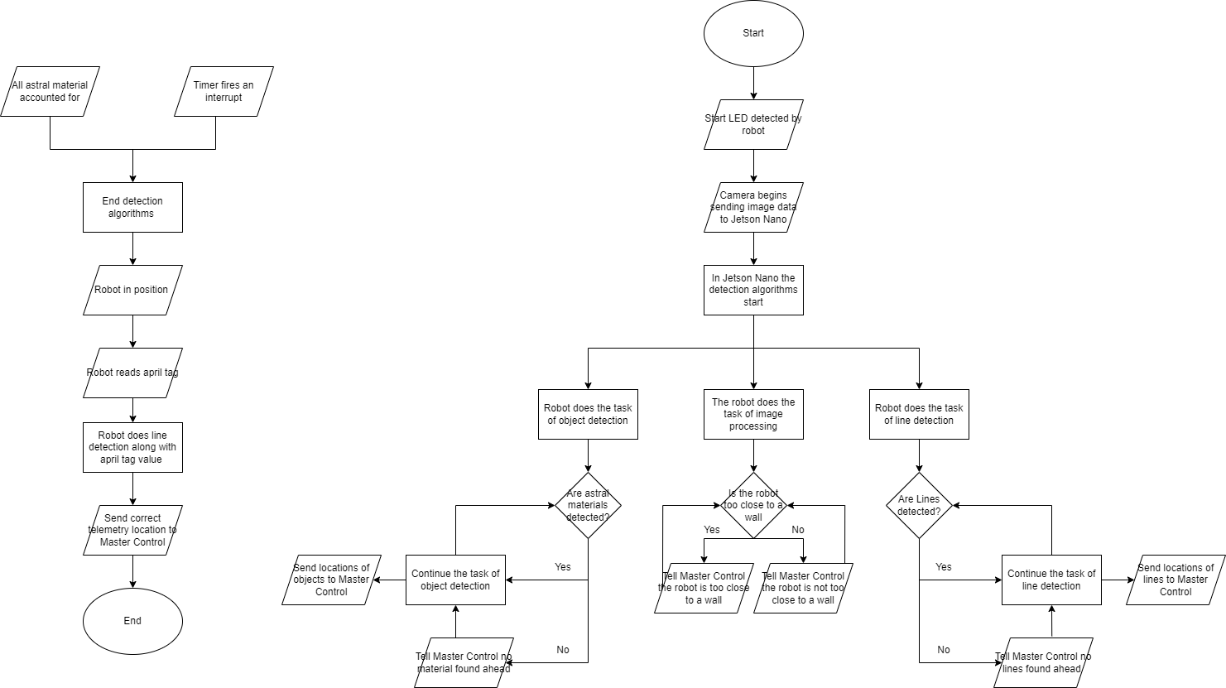

Slide 10
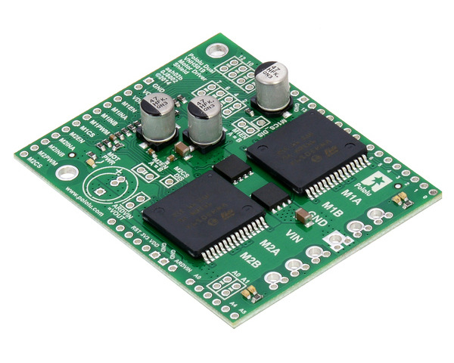
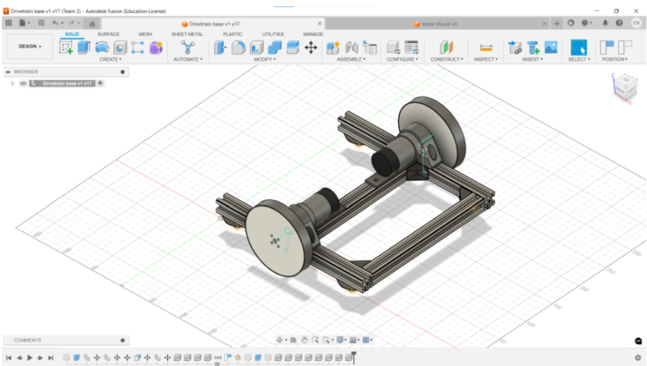
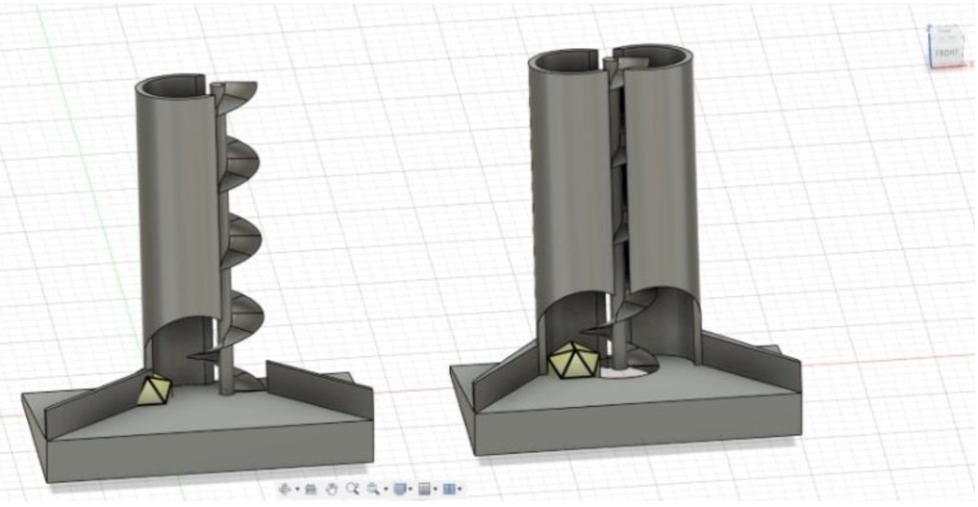
Motor Control Subsystem
Motorized Mechanisms
Drivetrain (PID Control)
Cosmic Shipping Container Arm
Material Collection Process
Roller and Auger
Material Sorting Gates
Beacon Arm
Specifications and Constraints
Motors shall meet Game Manual specifications and design constraints for optimal performance (speed, torque, voltage, current, load, etc.)
Subsystem shall abide by standard circuit protection measures as demonstrated by IEC 60204-1 through an emphasis placed on the following:
electrical supply
electromagnetic compatibility
emergency stop
control circuit protection
Analysis
Wheel speed
Torque
Maximum Power
Battery Life and Speed Relationship
PID Parameter Calculation (Drivetrain)

Slide 11
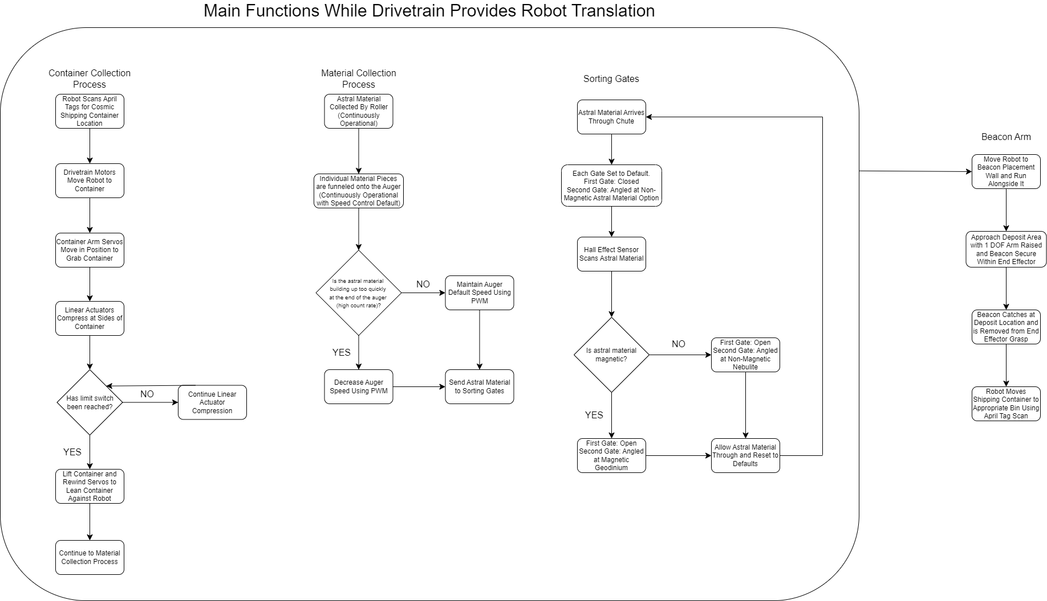
Motor Control Subsystem

Slide 12
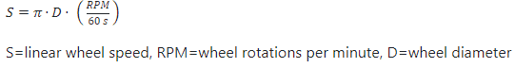
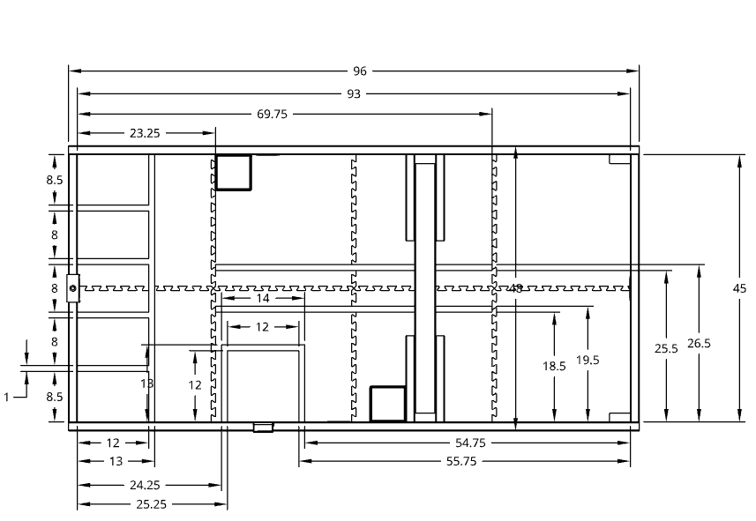
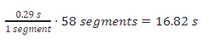
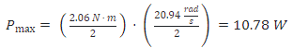
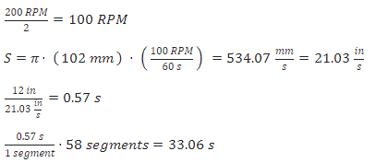
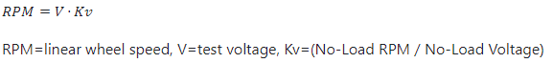
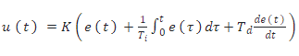
Motor Control Subsystem
Analysis:

Slide 13
Navigation and Master Control
Goals:
Take and interpret data from the various sensor subsystems.
Determine the path that will provide an optimal amount of points for an optimal time.
Send that data to the motor control subsystem.
Specifications:
The Robot shall act autonomously (Specification 1). This is necessary for compliance with Game Manual 1
The Robot shall be able to navigate to and position itself for the following tasks (Specification 2). This is necessary to maximize potential points.
Navigate out of Landing Pad
Navigate within 3 seconds of Start LED
Navigating into the cave
Navigate to correct shipping pad
Navigate to and allow for placement of team beacon
The Robot shall account for background interference (Specification 11). This is to help reduce potential failure points.
Constraints:
The Robot shall stay on the game field (Specification 5). This is necessary for the safety of the team and all IEEE SECON staff members.
The Robot shall cease all operation after 3 minute timer is done (Specification 10). This is necessary for the safety of the team and all IEEE SECON staff members.
The Robot shall immediately cease operations upon the usage of the emergency stop button (Specification 7). This is necessary for the safety of the team and all IEEE SECON staff members.

Slide 14
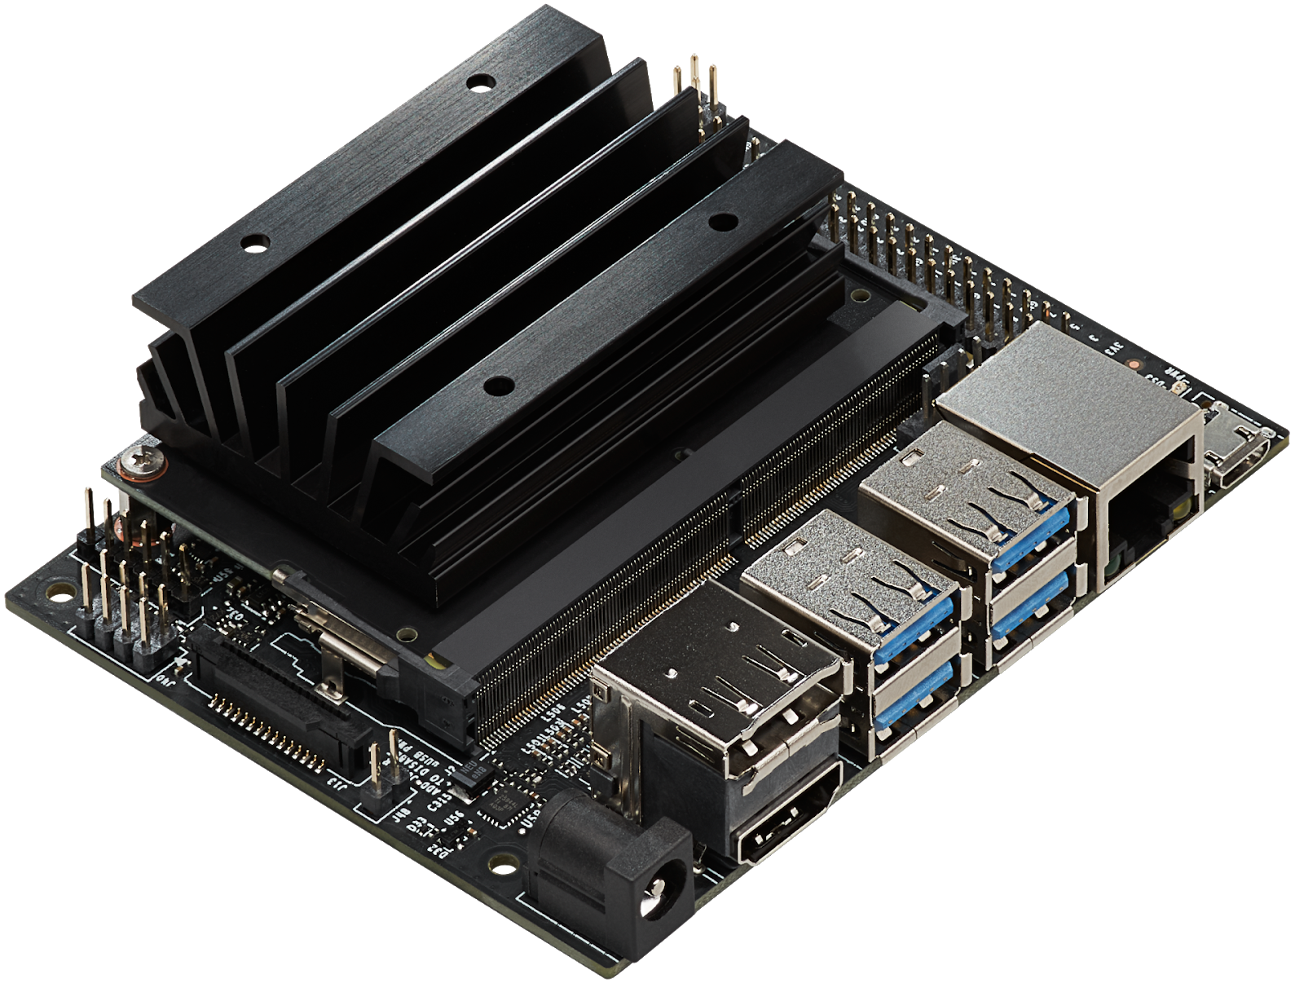
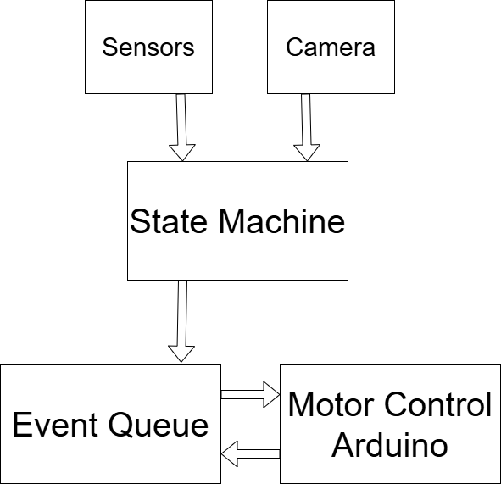
Navigation and Master Control
Solution:
Work with the camera and sensor subsystems to obtain usable data.
Interpret positional data via state machine using a mix of preprogrammed positions and A* algorithm
Hold positional data in event queue until motor control subsystem Arduino is ready
Send positional data to motor control subsystem Arduino
Receive completion feedback from Arduino, and process next event in event queue
Analysis:
Speed of Paths
Speed of A* algorithm
Number of Astral Material Gathered.
Jetson Nano
Flowchart

Slide 15
Contributions
Sean Borchers: Motor Control, Conceptual Solution Block Diagram
Alexander Cruz: Navigation and Master Control, Conceptual Solution
Samuel Hunter: Object and Line Detection, Broader Impacts
Alejandro Moore : Power
Dakota Moye: Sensors Subsystem, Problem Formulation, Specifications and Constraints

Slide 16
Thank you for your time

